Slide 1
NMAI INTERNSHIPS
Krishna L. Aniel
AnielK@si.edu
(202) 633-6988
Welcome! Please introduce yourself (name, year in school, major/minor)

Slide 2
Nmai Land acknowledgement
“We gratefully acknowledge the Native Peoples on whose ancestral homelands we gather, as well as the diverse and vibrant Native communities who make their home here today.”
https://americanindian.si.edu/nk360/pdf/Honoring-Indigenous-Inhabitants-Land-Acknowledgement.pdf

Slide 3
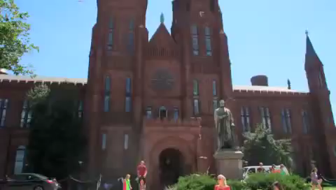
Interning at the Smithsonian

Slide 4
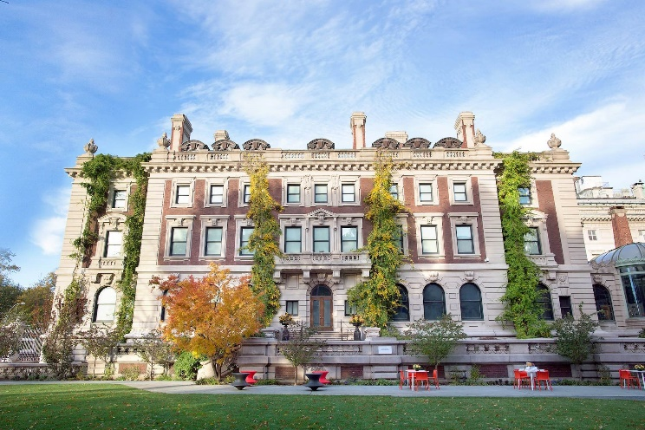
Smithsonian Background and History
The world’s largest museum complex:
https://www.youtube.com/watch?v=ht-V5HKjKBA
• Founded in 1846
• 19 museums and counting (not all in Washington, DC)
• 9 research centers + a recording label + the National Zoo
• 21 Libraries
• Approximately 6,700 employees and 13,500 volunteers
• Approximately 2,000 interns, fellows, & researchers
• Quasi-Federal Agency (mixed federal and trust funds)
• 215 Affiliate Museums (US, Puerto Rico, Panama)

Slide 5
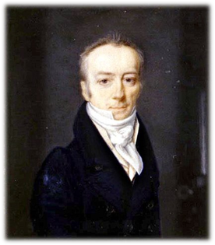
Who was James Smithson?
Founding donor of the Smithsonian who donated his estate of $500K (estimated at $12M today)

Slide 6
Who was James Smithson?
• Born 1765, illegitimate in France
• About age 10 became a naturalized English citizen
• Became a chemist and a mineralogist
• No heirs so bequeathed his fortune “to the United States
of America…under the name of the Smithsonian Institution,
an establishment for the increase and diffusion of knowledge…”

Slide 7
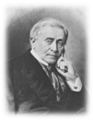


The Secretary: Smithsonian’s Highest Office
Joseph Henry (1797-1878) David Skorton, M.D. Lonnie Bunch, III
1st Secretary 13th Secretary 14th Secretary
1846-1878 2015 to June 15, 2019 2019 to present
Physicist Cardiologist Founding Director NMAAHC
Notes:
I deleted from Lonnie's, "Installation Ceremony, November 1, 2019"

Slide 8
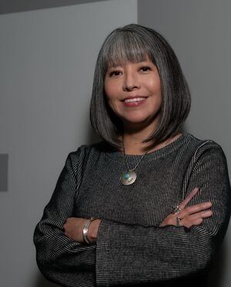
NMAI Director
Cynthia Chavez Lamar
(San Felipe Pueblo)

Slide 9
SI Internships & Fellowships at a glance...
• Internships: Guided learning opportunities
• Fellowships: Independent Research
Visit OIP’s website for all opportunities
• 60 plus programs offer an incredible range of mentor-based guided learning opportunities
• Not just curatorial • Be sure to check every unit
• More virtual opportunities • Central versus Unit

Slide 10
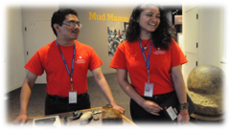
SI Internships: General Background
• Over 1,800 interns/year
• Internships run anywhere from 2 weeks to 6 months (most are 10 weeks)
• Summer is the busiest – and most competitive time
• Paid/Unpaid
• Both U.S. and foreign nationals

Slide 11
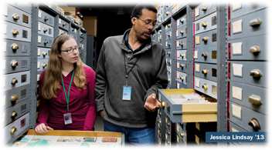
SI Fellowships: General Background
• Over 1,000 fellows/year
• 10 weeks – 4 years
• Paid/Unpaid
• Both U.S. and foreign nationals
SORS Guide
The Smithsonian Opportunities for Study and Research (SORS) Guide can help you see the scope of possibilities for advisors and research topics in your field of study.

Slide 12
NMAI Collections
Object Collections: 840,000 items represented by 270,000+ catalogue numbers, divided into Archaeology, Ethnology, and Modern and Contemporary Arts.
Photographic Archives: approximately 324,000 images documenting nearly all aspects of Native American life from the mid-nineteenth century to the present as well as images document Museum of the American Indian (MAI) and NMAI events, exhibits, staff research, expeditions throughout the hemisphere, repatriations, and behind-the-scenes work.
Paper Archives: about 1522 linear feet of records that date from the 1860s to the present preserve the documentary history of the NMAI, its predecessor, the MAI, and other materials, including the organizational papers of the National Congress of American Indians (NCAI).
Vine Deloria Jr. Library: research materials include over 40,000 volumes of books, periodicals, microfilm, and media in the main collection; a small, but growing rare book section; Native American Artist Files; and ephemera.

Slide 13
NMAI APPLICATION DEADLINES & Start dates
Fall: July 15th deadline and start last week of September
Winter/Spring: November 15th deadline and start third week of January/March
Summer: March 15th deadline and start second week of June
Smithsonian OnLine Academic Appointment (SOLAA) application:
  Applicant Information
  Statement of Interest (list 2-3 departments and explain your interests/goals)
  (Unofficial) Transcripts
  Resume
  (2) Recommendation Letters
Notes:
Here are the general NMAI internship start dates and end dates and semester application deadlines. Regarding eligibility, a cumulative GPA of 3.0 or higher is generally expected. Stipends may be provided to selected interns based on financial need and range from approximately $1,000 to $8,000 dollars for a 10-week session. Most interns at the Smithsonian are university undergraduate, graduate, or recent graduates, but you do not have to be a current student. The SOLAA application consists of five sections and detailed instructions can be found on our website. Only complete applications will go on to be reviewed for the selection process.

Slide 14




Slide 15
NMAI Vision Statement
Equity and social justice for the Native peoples
of the Western Hemisphere through education,
inspiration and empowerment.
Mission Statement
In partnership with Native peoples and their allies,
the National Museum of the American Indian fosters
a richer shared human experience through
a more informed understanding of Native peoples.

Slide 16
Creating a Meaningful Internship Experience
Culture Transmission (KA) – the “big picture” and what you want them to know about your company, industry, etc.; NMAI publications and enrichment activities
Professional Development (KA)– what are the “soft skills” or core competencies that are important for success in your organization; InternBridge Brown Bags
Meaningful Projects (Mentors) – projects and assignments that are challenging and developmental; more technical or hard skills
Networking (Mentors) – including your intern in departmental meetings/events when appropriate; introducing them to other staff; helping your intern set up informational interviews when you are out/on vacation

Slide 17
Is there financial support (i.e., a stipend) for this internship?
Yes, to students whose applications are on time and who are accepted. Per Smithsonian Institution regulations, stipend amounts range from about $1000 to $7500 for an onsite ten-week session, depending on the amount of funds available at the discretion of the museum. Virtual internship stipend amounts are approximately up to $2,500, depending on home office equipment/technology needs.
Academic Credit
The Smithsonian Institution welcomes the opportunity to work cooperatively with schools seeking to grant academic credit for internships. Applicants are encouraged to initiate arrangements for credit with their colleges or universities. The Smithsonian does not grant academic credit.
Notes:
NMAI Internship Program provides educational opportunities for students interested in the museum profession and related fields. Interns complete projects using the resources of NMAI and SI offices. Internships are an opportunity for students to learn about the museum’s collections, exhibitions, programs, and methodologies, and to meet professionals in the museum field.
Interns are selected by a review committee made up of NMAI staff. Approximately twenty-five percent of applicants are accepted for internships during any one-year period.

Slide 18
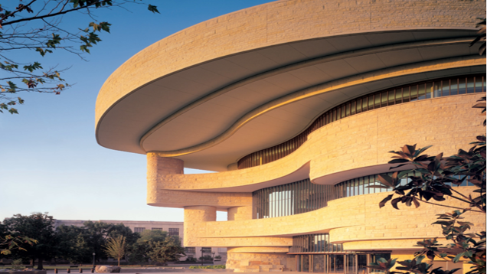
The National Museum of the American Indian in Washington, D.C.
Fourth Street and Independence Ave., SW, Washington, DC 20013
Opened on the National Mall on September 21, 2004, NMAI-DC is
a major exhibition space for Native art and material culture
as well as a center for educational activities and performances.
Notes:
The internship program at NMAI is one of 60 plus internship programs within the Smithsonian Institution. The Office of Fellowships and Internships (OFI) is the central office coordinating all internship programs at the Smithsonian. Usually applicants review several internship program descriptions and links offered by OFI on their informational web page to determine which programs are of interest to them. Once you have narrowed down your list of internship programs, you can apply for each one via the Smithsonian's OnLine Academic Appointment or (SOLAA) application system. Once you have completed one program application, you can apply for a different program by copying the basic information from your first application. This makes it easy to apply for multiple internship programs. Naturally, applicants will want to tailor the details of each application to a specific program.

Slide 19
The following list provides a general overview of the departments within NMAI-DC who have hosted interns:
• Collections Care • Cultural Interpreter Program
• Development • Education • Executive Office
• imagiNATIONS Activity Center
• Marketing and Communications
• Media Production • Public Programs
• Special Events • Technology
Notes:
Departments at DC as of September 25, 2020

Slide 20
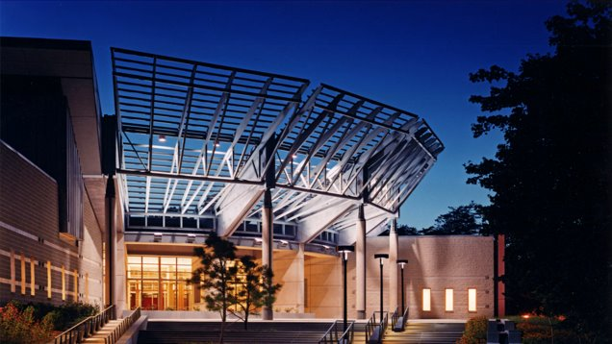
Cultural Resources Center in Suitland, MD
4220 Silver Hill Road, Suitland, MD 20746
Located just southeast of Washington, D.C.,
the CRC houses NMAI’s collection of more than 800,000 objects, representing indigenous cultures throughout the Americas.

Slide 21
The following list provides a general overview of the departments within the CRC who have hosted interns:
• Archive Center • Collections
• Collections Information & Asset Management
• Collections Research & Documentation
• Conservation • History & Culture
• Registration • Repatriation
• Safety • Technology
Notes:
Departments at CRC as of September 25, 2020

Slide 22
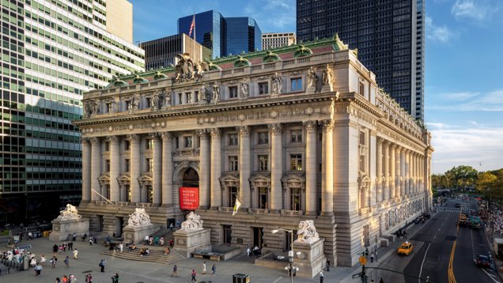
The National Museum of the American Indian in New York City
One Bowling Green, New York, NY 10004
Features temporary exhibitions and a range of public programs.

Slide 23
The following list provides a general overview of the departments within NMAI-NY who have hosted interns:
• Collections Care
• Cultural Interpreter Program
• Education
• imagiNATIONS Activity Center
• Marketing and Communications
• Special Events
Notes:
Departments at NY as of September 25, 2020

Slide 24

Questions & Discussion
Collaborations & Connections
Visit our website: https://americanindian.si.edu/about/internships
or email nmaiinterns@si.edu

Slide 25
