Slide 1
Creating Your Own Pathway

Slide 2
College and Career Goal Setting and Understanding Self-Identity

Slide 3
Number 1 Rule
RESPECT

Slide 4

AGENDA
Introductions
What is TEDNA ACE
Who is Tashina
TEDNA Video
Ice Breaker- Rep the Room
ME Poster

Slide 5
“There are two important dates in your life, the day you were born, and the day you realize why”.
~Mark Twain

Slide 6
What is TEDNA-ACE?

Slide 7




The grant was awarded in October of 2020 and is partnered with four tribal nations.

Slide 8


Slide 9
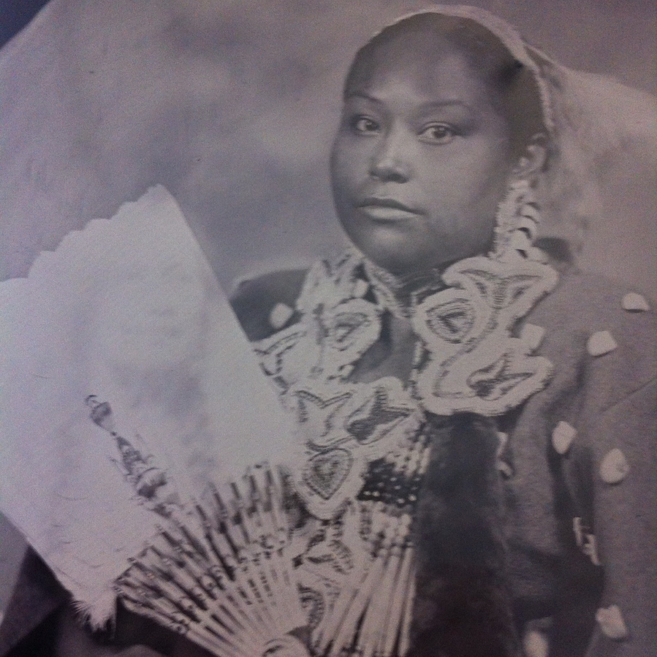
Hello!
Tashina Tahdooahnippah, M.Ed.
TEDNA ACE- Senior Education Specialist
Cheyenne and Arapaho Tribes of Oklahoma

Slide 10
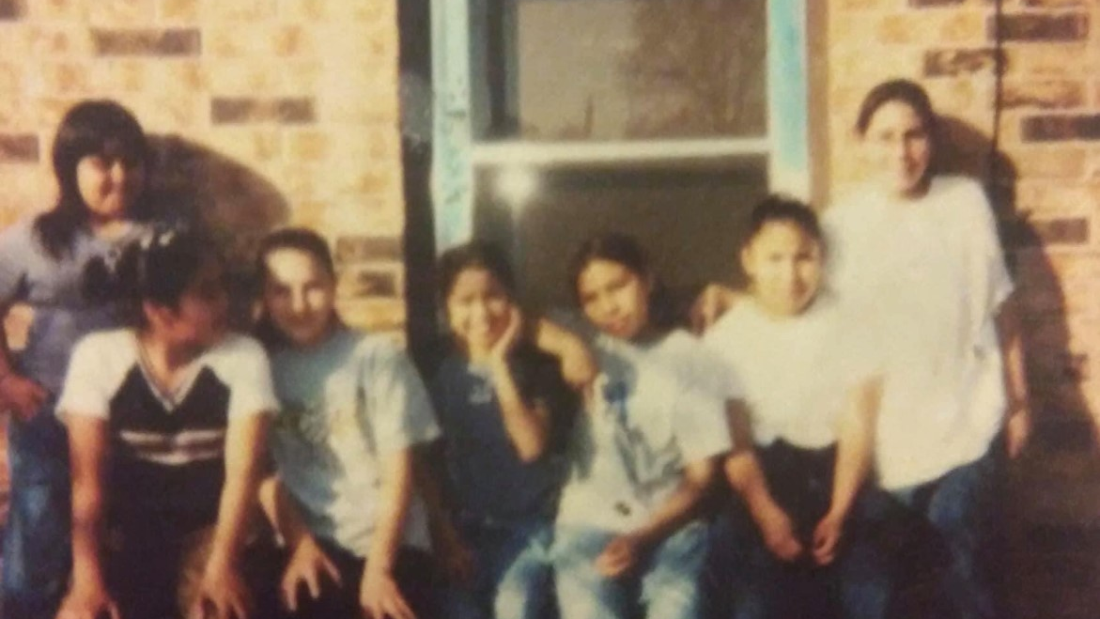

Slide 11
Originally from Lawrence, Kansas
Enrolled member of the Cheyenne and Arapaho, also Comanche, Kiowa and Kickapoo of Kansas
Employed with the Cheyenne and Arapaho Tribes 10 years this November
Alumni-Haskell Indian Nations University (BA), University of Central Oklahoma (Masters of Ed), Southeastern Oklahoma State University (Masters of N.A. Leadership)
Current Doctoral student majoring in Educational Leadership
Partnered with TEDNA for 7 years

Slide 12
TEDNA CAMPS 2022

Slide 13
Academic Camp Riverside Indian School Anadarko Oklahoma June 2022
https://vimeo.com/718832270

Slide 14
Cultural Camp Sovereign Community School Oklahoma City, Oklahoma June 2022
TEDNA SOVEREIGN.mov

Slide 15
Academic Camp College of Muscogee Nation Okmulgee, Oklahoma June 2022
https://www.facebook.com/cheyenne.arapahotelevision/videos/1487504018373814/?extid=CL-UNK-UNK-UNK-IOS_GK0T-GK1C

Slide 16
ICE BREAKER

Slide 17
Rep the room
Classmen
Region
Athletes
Leaders

Slide 18
Who are you?

Slide 19
ME POSTER

Slide 20
Divide the Poster
3 sections: College/ME/Career
CAREER
COLLEGE
ME

Slide 21
“ME”
Name
Tribe(S)
Grade
School
Location
Sibilings?
Big on family?
Traditional
Dance/Sing?
Favroite Color
Favorite Sport
Favorite Team
Favorite Song
Favorite Movie
Talkative
Laid back
Athletic
Places you traveled
Favorite Vacation
How many Unity Conferences have you attended?

Slide 22
College
Where would you go?
Name/Location/Colors/Mascots
Undecided?
What are your post graduation plans?
What would you study?
Major/Clubs/Sports
Why do you want to go there?
Family legacy/On the other side of the country/ Local/ Major friendly

Slide 23
Career
Career 1
If you could work anywhere tomorrow, what would you be?
Career 2
If you could develop a career over time, what would you do?
Career 3
What is your dream job and where is it located?

Slide 24
Life Goals-ME
Name 3 life goals you want to reach in your lifetime
Examples: Travel to a foreign country, Learn a new language, Skydive, Swim with Whales, Forrest Gump run through the US, Invent a new flying sneaker….
Possibilities are endless…This is your story.

Slide 25
Thank you!

